Slide 1
Smart Curtain System
Final Presentation
Team 3N3
Notes:
David

Slide 2





Meet the Team
Arthur Chen, ‘22
Project Leader
David Erdner, ‘22
Systems Design
James Streets ‘22
Hardware Design
Pierre Vu, ‘22
Software Design
Caleb Key, ‘22
Testing, Technical Reporting
Notes:
https://crop-circle.imageonline.co/
David (1:00)

Slide 3
Agenda
Problem and Requirements
System Design
Engineering Standards
Project Management and Teamwork
Results
Notes:
David

Slide 4

Problem and Requirements
No Smart Curtain System Available on Market right now
Current products do not have environment measuring ability so no automatic energy saving algorithm applied
Requirements for our system to solve problem:
Measure Environment and Surroundings
Automatically Control Curtains via Android Application
Save Energy by Opening/Closing Curtains Based on Environment
Notes:
David

Slide 5

System Design - Alternatives Considered
Building our own motor
Would have made unbalanced hardware/software components of the project
Using Simple Smart Curtains
Too bulky, not available for open source development
Graywind Motorized Shades
Too bulky, too expensive
Notes:
David (2:15)

Slide 6
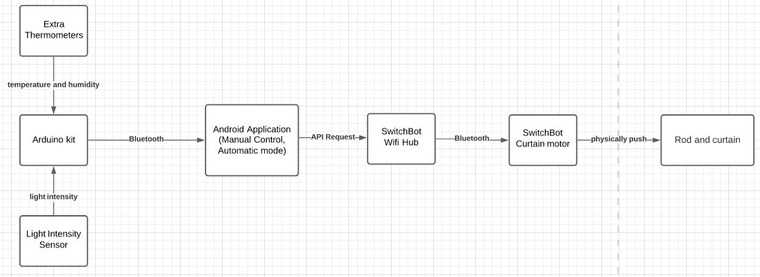
System Design - Overall System-Level
Notes:
6-7 Pierre

Slide 7
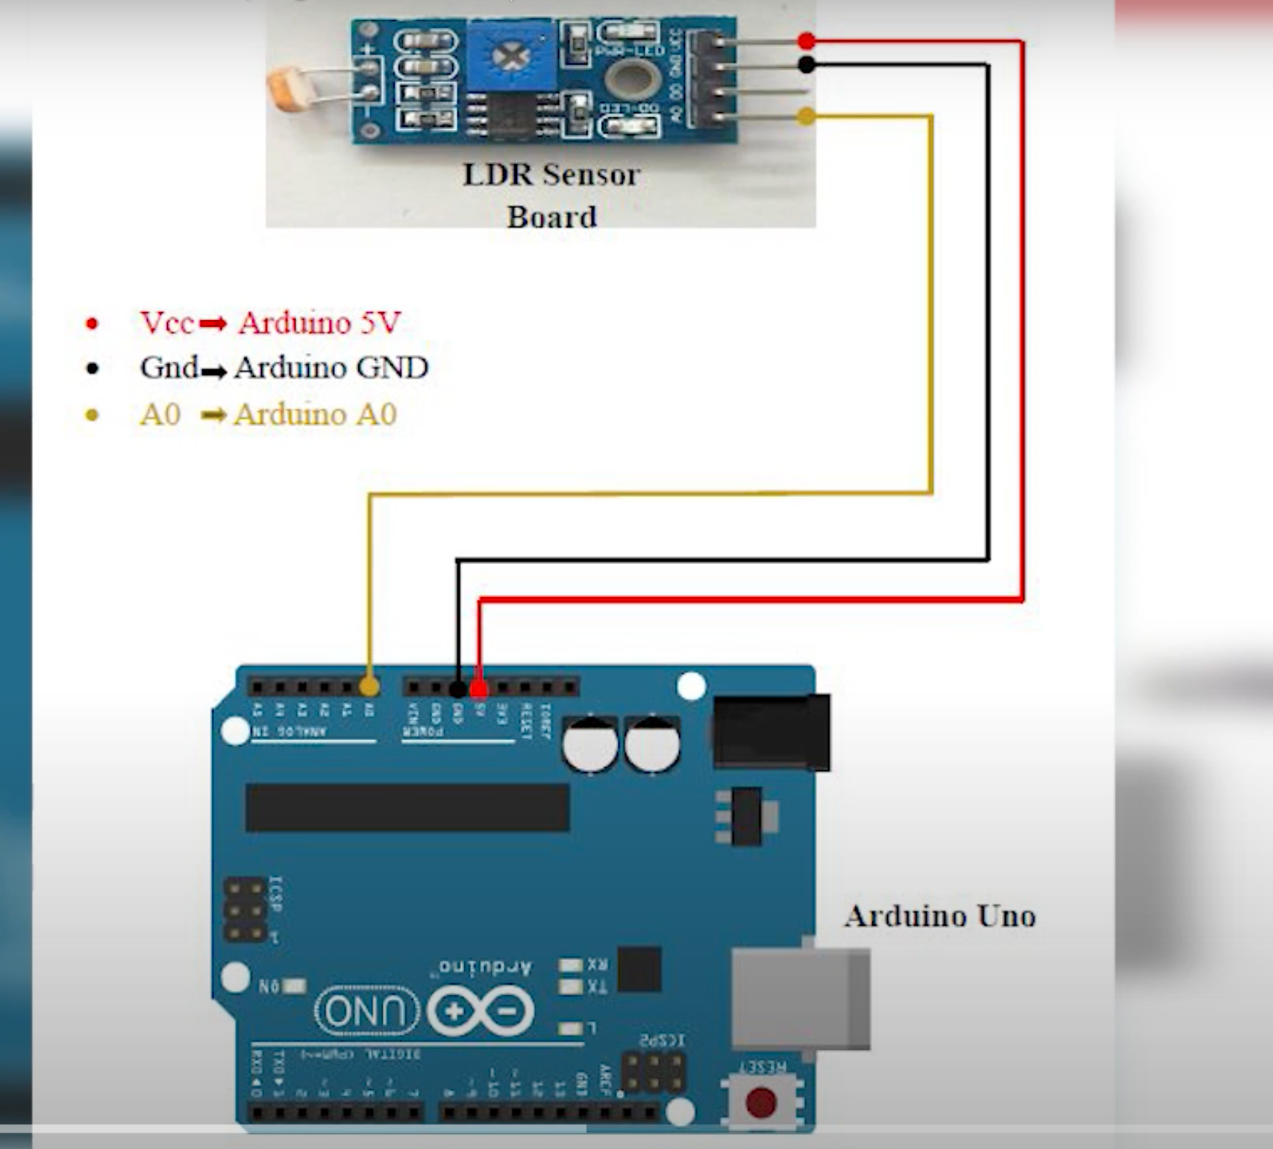
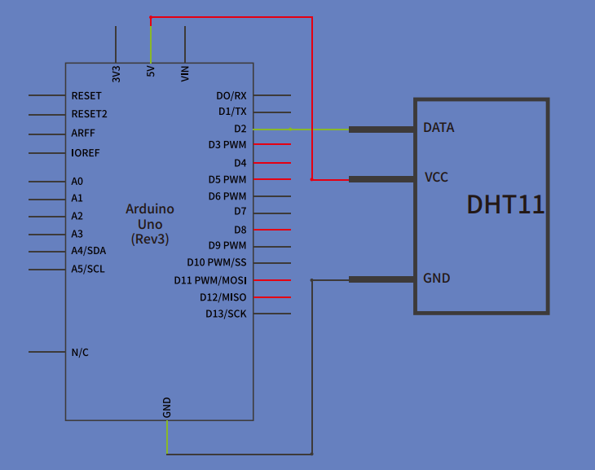
System Design - Components: Arduino
Notes:
(3:05)

Slide 8
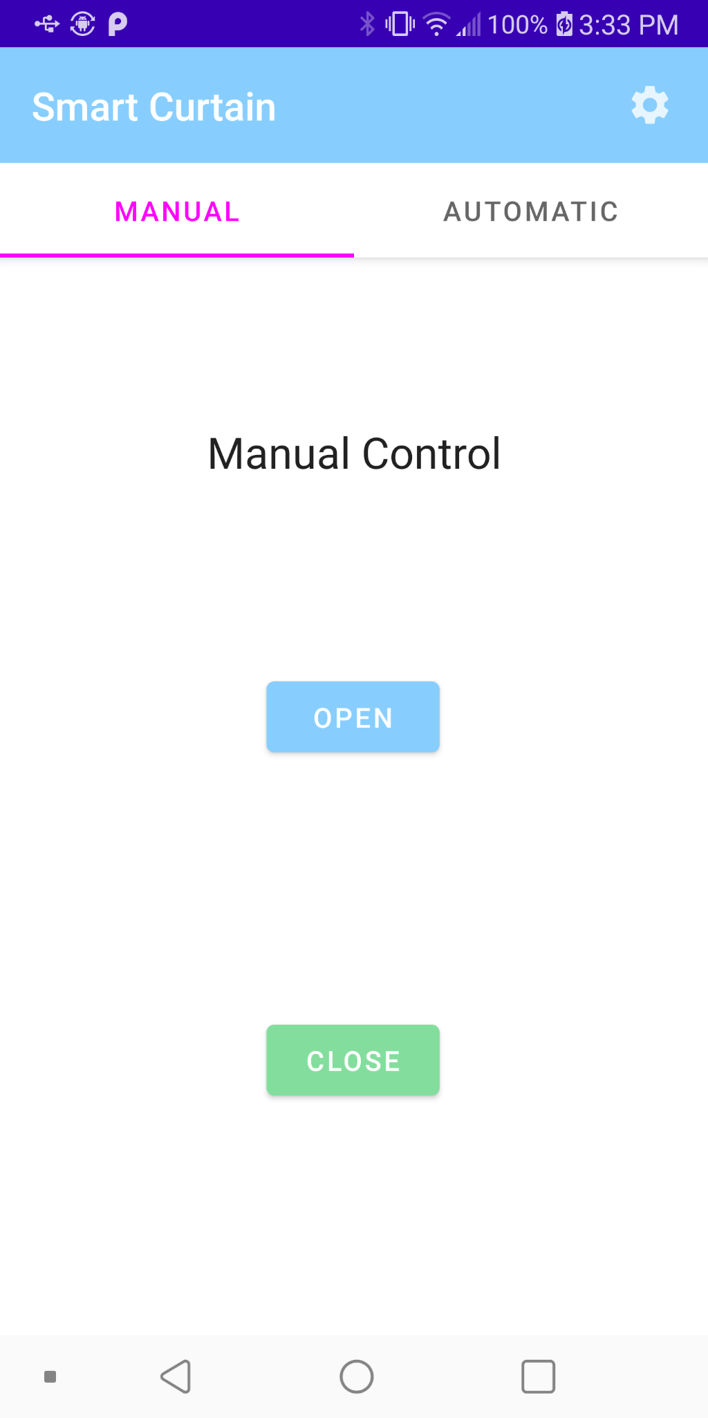
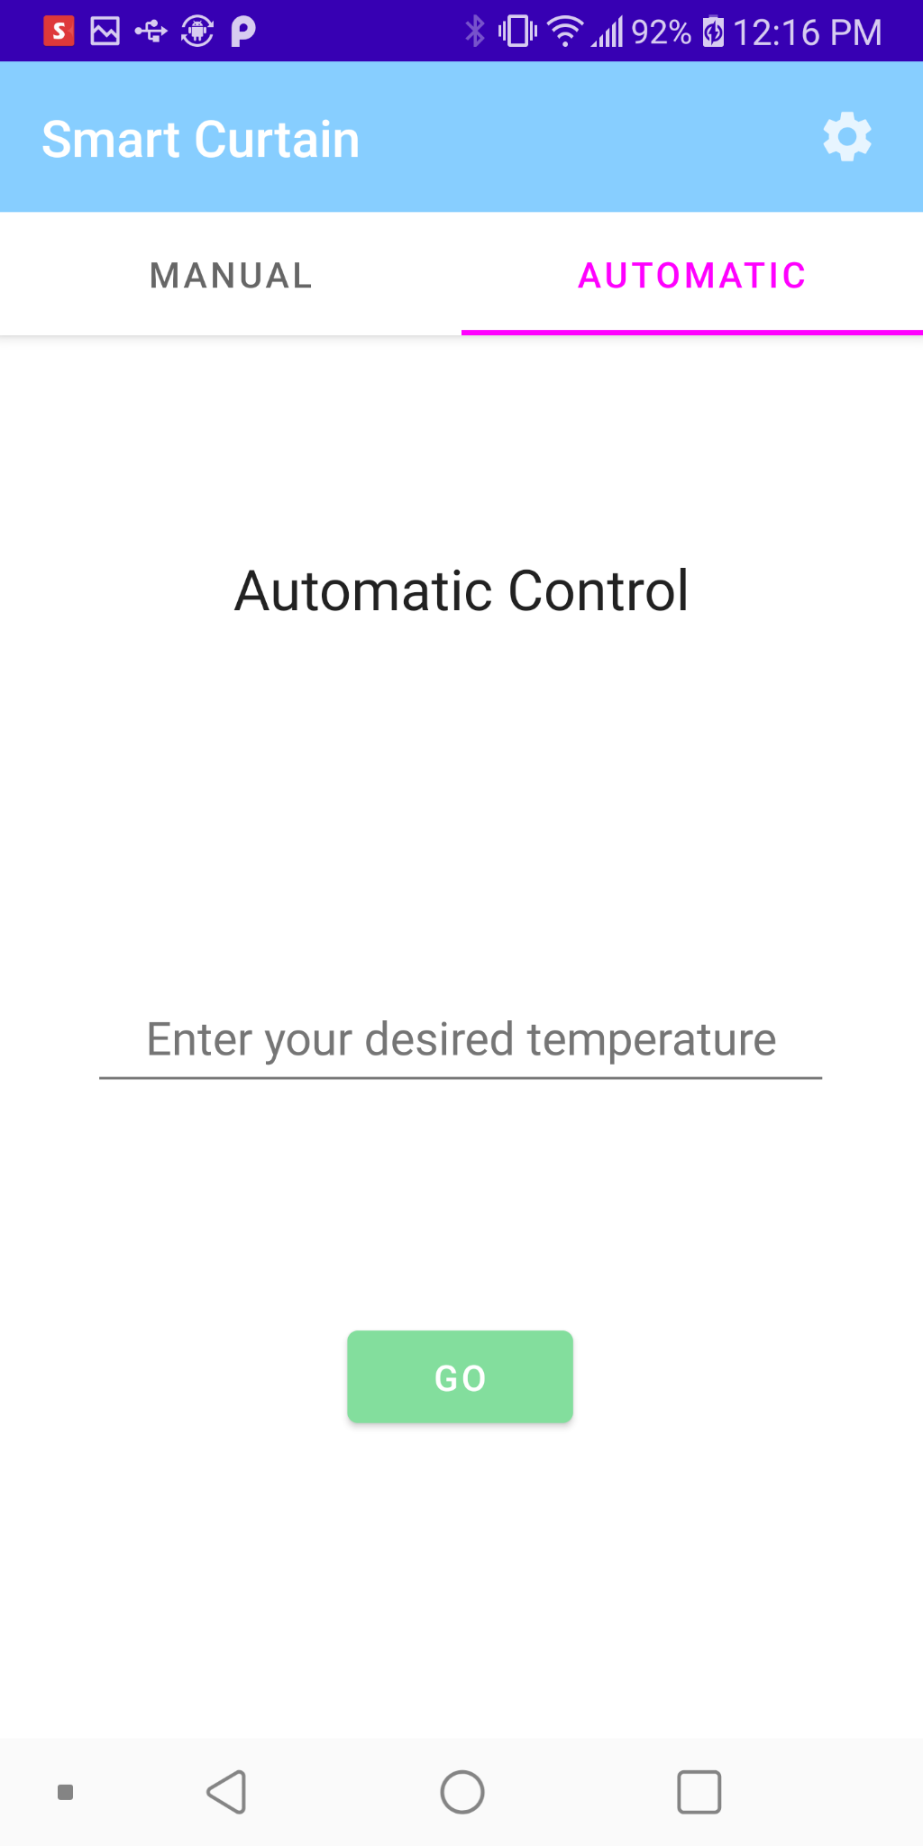
System Design - Components: Android App
Notes:
8-10 James

Slide 9
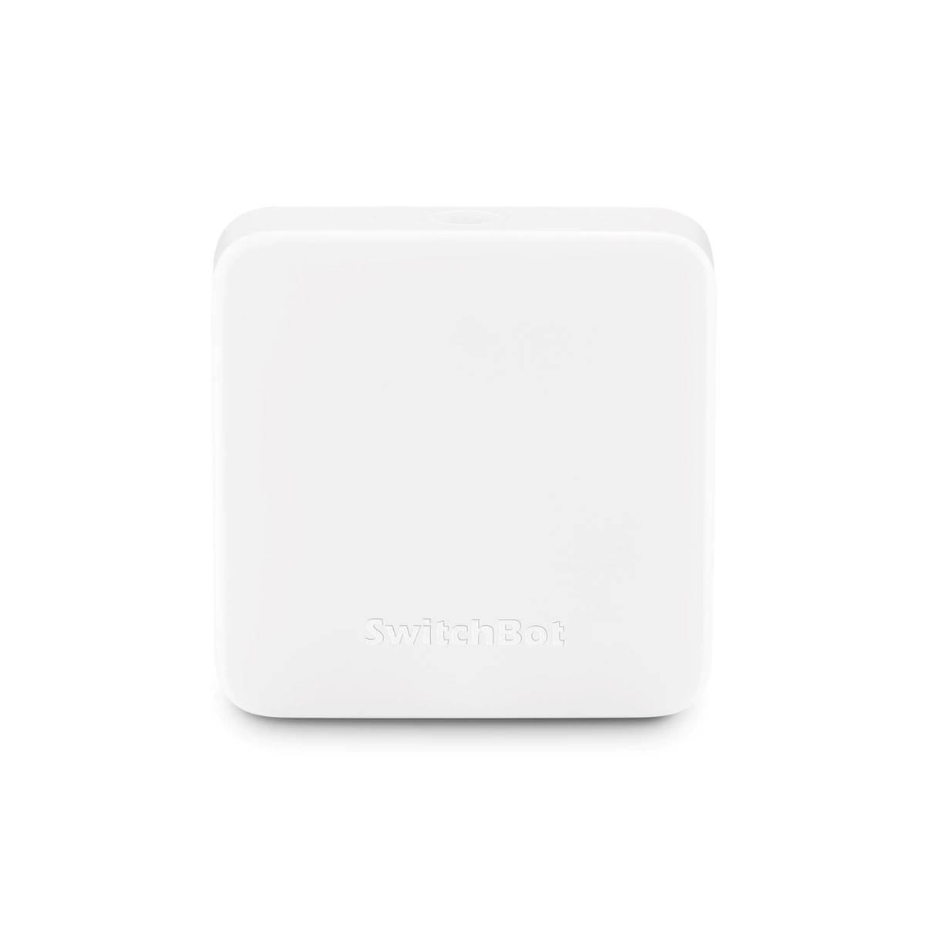
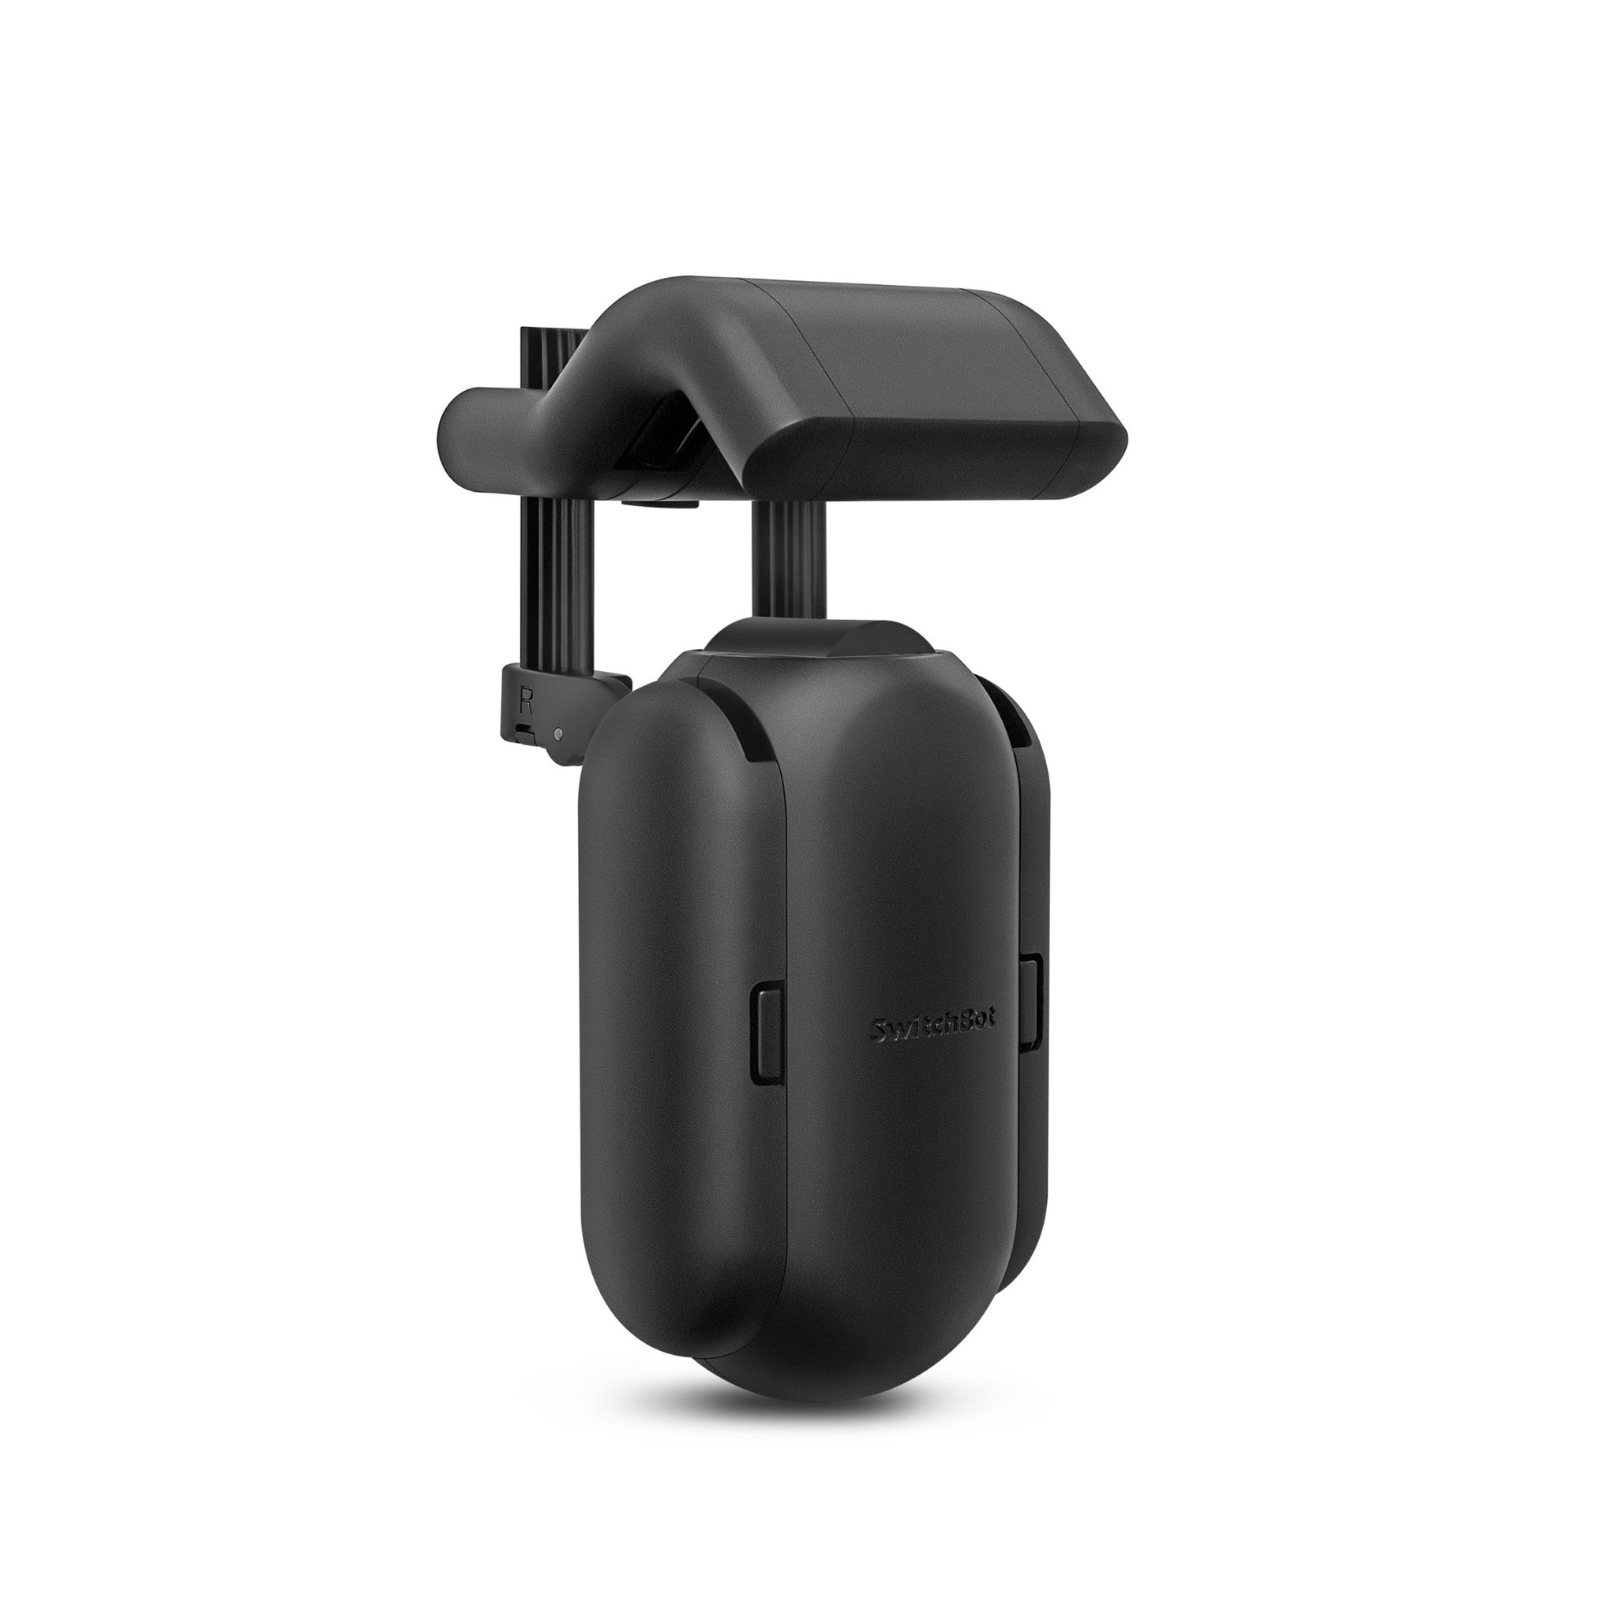
System Design - Components: Curtain Motor

Slide 10
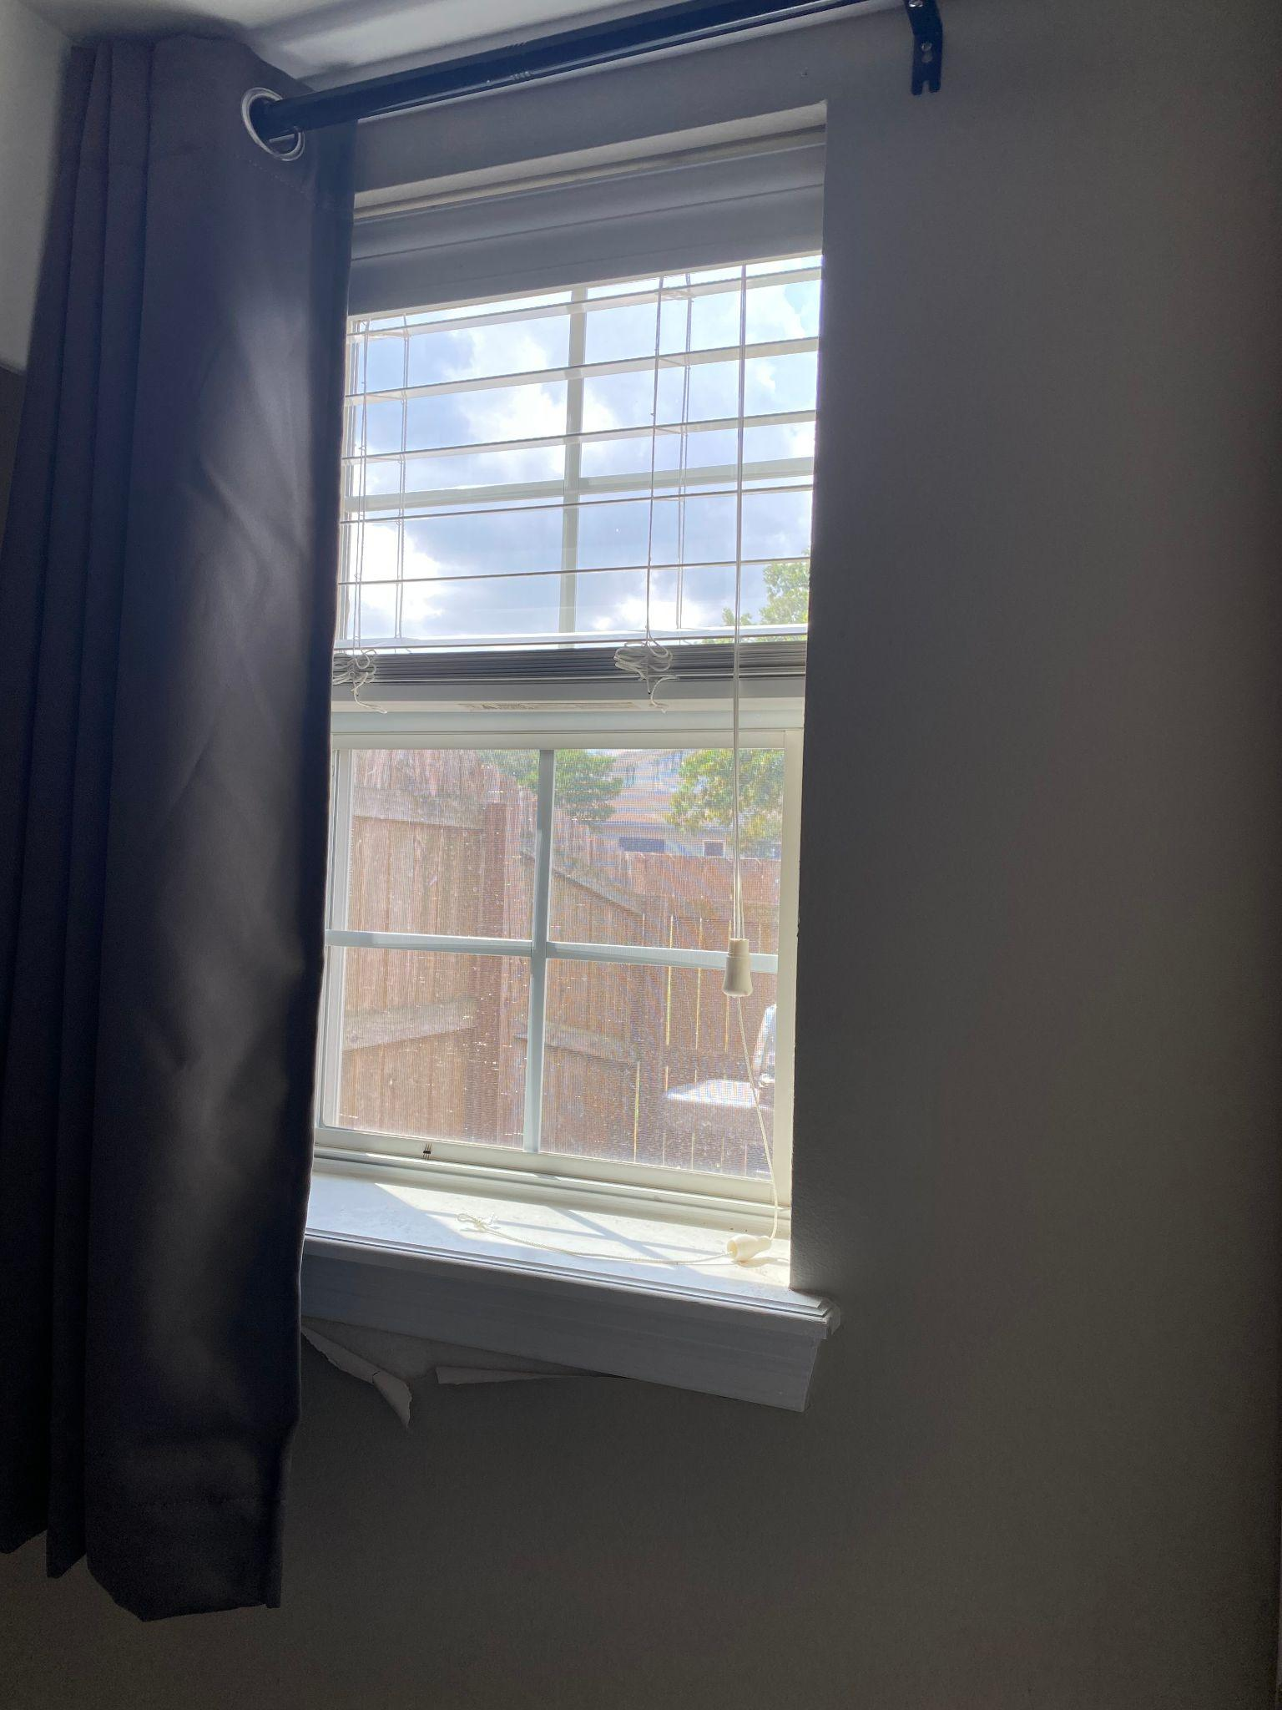
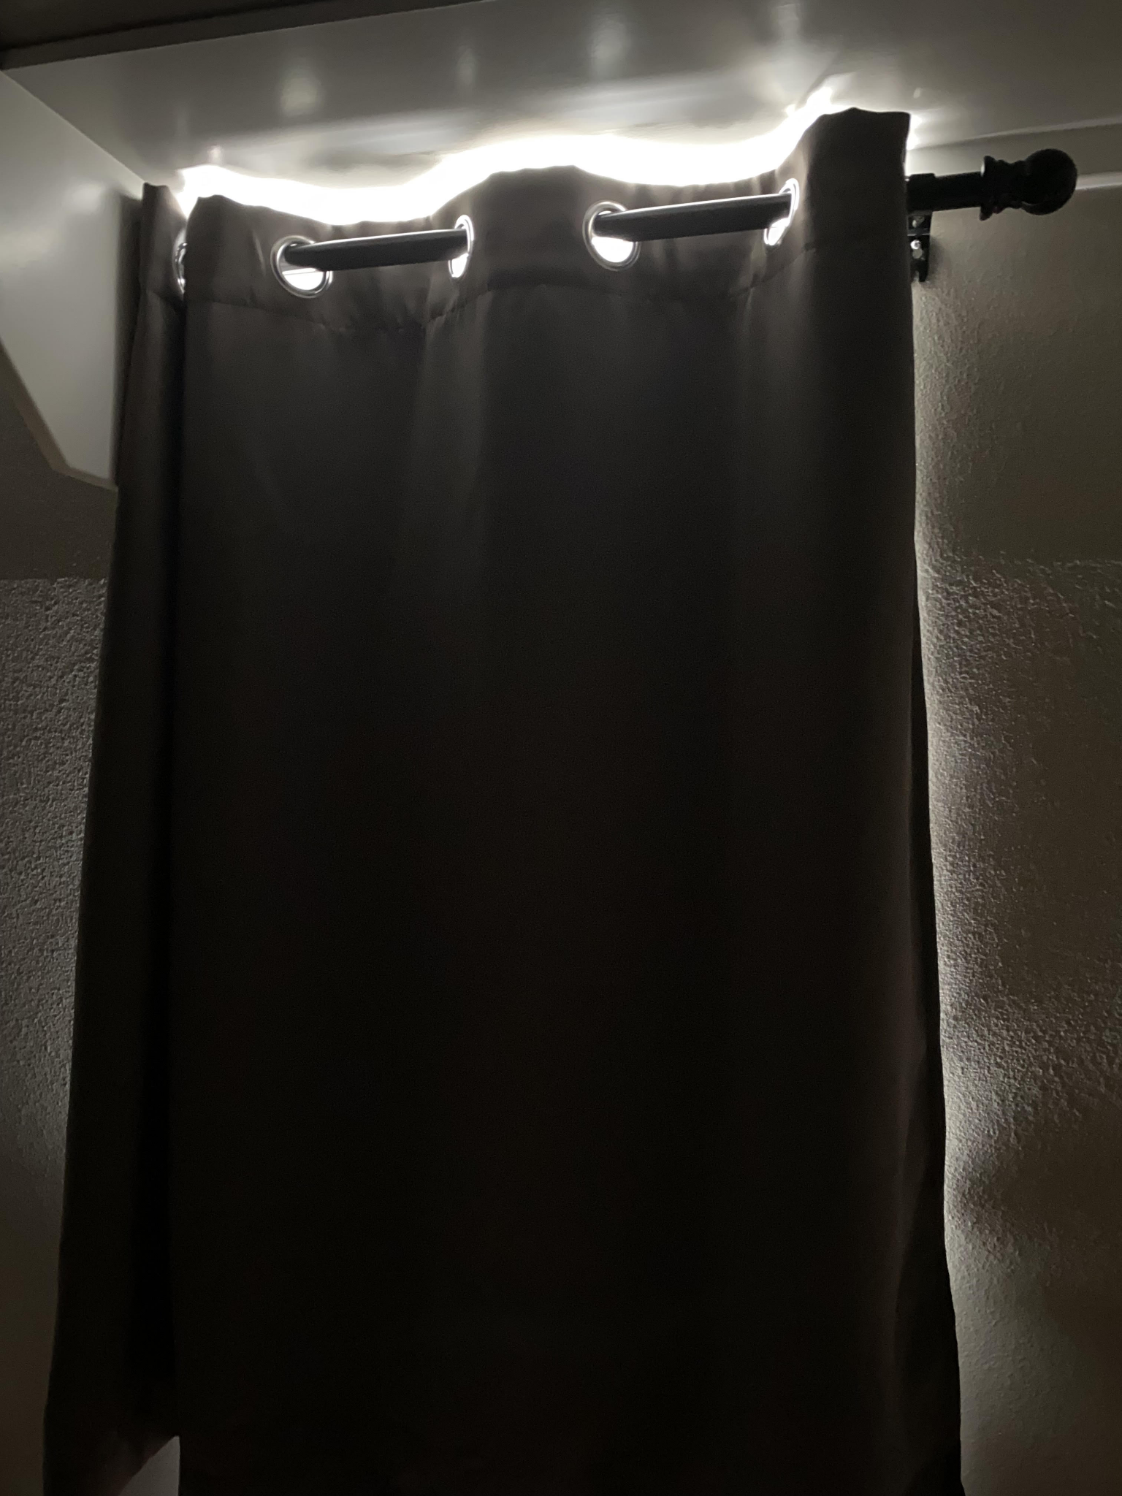
System Design - Components: Black Out Curtain
Notes:
(4:40)

Slide 11

Engineering Standards - Environmental, Health and Safety
Environmental
Saving energy has a positive impact on the environment
Health
Sedentary lifestyle
Safety
Area of use must be considered
Must be mounted properly
Notes:
11-14 caleb

Slide 12
Engineering Standards - Social, Political, and Ethical concerns
Social
Curtain motor can be loud, so turning on and off while user is sleeping could be distracting
Political
Privacy could be an issue with automatically opening curtains
Ethical
More automatic home appliances increase human reliance on technology for simple tasks

Slide 13
Engineering Standards - Manufacturability, Sustainability, and Economics
Manufacturability
Most of the project is done through the Android App. Only a few hardware components are required, so manufacturability is very manageable
Sustainability
Motor battery life is very good
Arduino components have some risk of burnout
Economics
Economically feasible because of the amount saved by homeowners (See results slide)
Notes:
11-14 Caleb

Slide 14
Economics - Budget
Component | Price
Microcontroller kit | $38.99
SwitchBot Curtain motor | $99.00
Curtain Remote | $16.15
Extra Thermometers | $10.29
Light Intensity Sensor | $10.99
Bluetooth Module for Microcontroller(2) | $18.00
Rod for holding curtains | $19.00
Black Out curtains | $16.00
SwitchBot MiniHub | $39.00
Total | $267.42

Slide 15
Results - Testing
Component Testing (Hardware and Software)
Integration Testing
Integrate hardware and software piece by piece
Satisfactory hardware frequency for software input
System Testing separated into 2 parts:
Manual Testing
Automatic Testing
Notes:
11-14 (8:38)

Slide 16

Project Management and Teamwork
5 Main Roles:
Team Leader
System Designer
Software Designer
Hardware Designer
Testing
Each person mainly responsible for one role
Communication and help between roles was critical
Discord for communication, Gantt and Flow Charts for task and schedule management, multiple weekly in person meetings
Notes:
15-17 Arthur

Slide 17

Results - Final Product Demo: Manual Mode

Slide 18
Results - Final Product Demo: Automatic Mode
Notes:
(12:00)

Slide 19
Results - Home Improvement & Energy Saved
Home Improvement
The ability to open/close your curtains with the touch of a button improves the quality of life for users, and is the next step in home improvement
Energy Saved
10%-25% of thermal energy loss is through windows
25% of this energy can be saved with a blackout curtain
If used in automatic mode, system can save the average homeowner roughly $125 per year
https://applianceanalysts.com/cost-to-run-central-air-conditioner
https://home.howstuffworks.com/green-living/blackout-curtains-save-energy.htm
Notes:
18 David (13:54)

Slide 20
Questions?
Notes:
Arthur End

